Slide 1
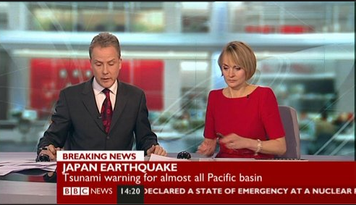
Codes and Conventions of Factual Programming
By Michael Gomersall

Slide 2
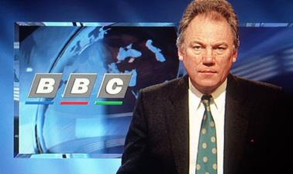
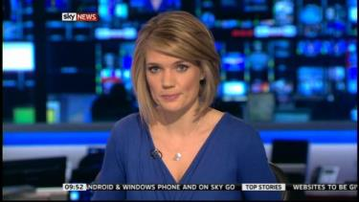
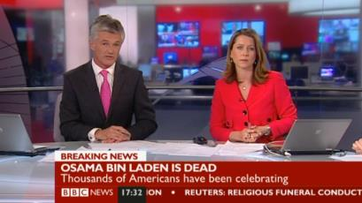
Studio News Readers
‘Anchor’ the show
Speak clearly
Formal presentation
- What they wear
- How they speak
Don’t show emotion
Not Biased
Talk directly to camera
Use autocues
Sit at a desk
Visuals or workplace behind them
Introduce footage/reports
Talk over visuals

Slide 3
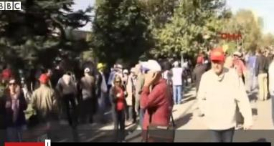
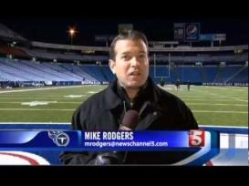
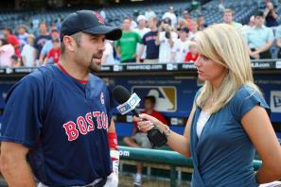
Field Reporters
Similar to studio news readers
Go out on location where news is happening
Often report ‘live’ from event
Interview witnesses/people who have been affected.
Talk over footage
Talk in a formal manner
Don’t show emotions
May look at camera or at person they are interviewing

Slide 4
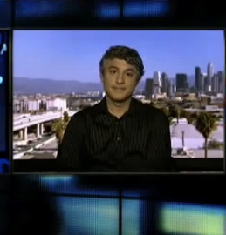
Links to Studio
Links to studio is when the news room connects with another studio which might have more information on a story.
The news reader would turn around to make the interview
An ‘expert’ might be nearer a different studio so it is handier to go there for an interview.
A national studio might link to a regional studio to get more information on a local story which has national importance.

Slide 5
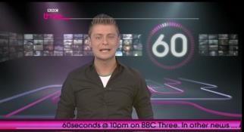
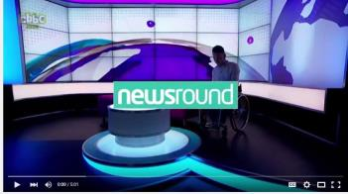
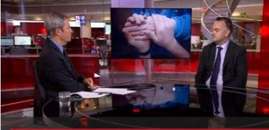
Mode of Address to Viewer
Targeting the show to a specific audience
60 Second News on BBC 3 is for young adults. It has short snippets of news and has celebrity stories
Newsround is produced by CBBC for children. Explains stories simply and can often focus on the how stories affect children and animals.
BBC News Channel delivers breaking news, analysis and in depth coverage all day and every day

Slide 6
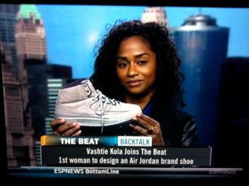
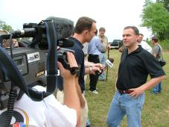
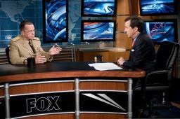
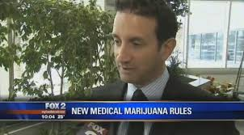
Interviewing
Interviews get first hand information/opinions about a story from experts or witnesses.
Different opinions and points of view
More information
Human Interest

Slide 7
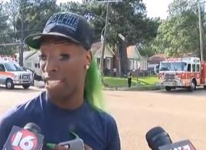
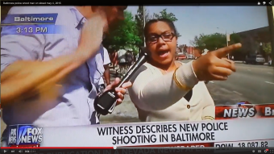
Experts and witnesses
An expert knows a lot about their specialist subject.
They can give information or analysis on what is happening
Audiences may trust their expertise
A witness has seen the news at first hand
They can add human interest as the audience can relate to them
The audience gets a ring side seat into events.
They are a primary source.

Slide 8
Report Structure
Report Structures may be different depending on the targeted audience but may include;
News Headlines
Most important/dramatic stories first
News reader doing a piece to camera
Cut aways to field reporters
Interviews of witnesses/experts
Sports
Weather
Light human interest story to finish.

Slide 9
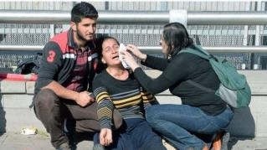
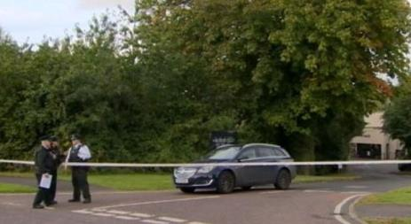
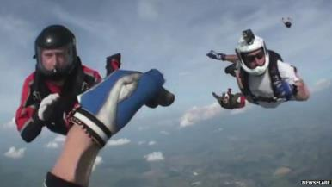
Actuality Footage
Actuality footage shows the events.
The camera is the eye witness
The audience can see events as they unfold
Showing has more impact than telling
Voiceovers explaining events

Slide 10
Documentary Formats

Slide 11
Expository
Expository documentaries expose stories that the general public may not know about.
Format: A commentator talks over pictures and video to tell the story
Can be formal, showing events, using interviews, witnesses, experts
Examples: Dispatches, Unreported World

Slide 12
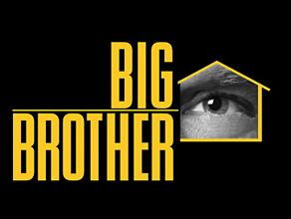
Observational
In observational documentaries the camera (audience) observes the action.
Format: Camera follows people or animals about observing what happens to them. No interviews. Voiceovers for the nature documentaries but not so much for human observational.
Long takes
Hidden film maker
Use of hand held cameras
Informal
‘Fly on the Wall’

Slide 13
Interactive
In an interactive documentary the film maker/crew can interact with the subject of the documentary.
Audience feels a personal connection
Fun
Captivating
Events influenced by film maker

Slide 14
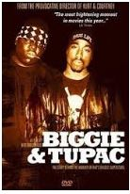
Reflexive
Reflexive documentaries include the process of how the documentary is made.
Biggie and Tupac is an example of a reflexive documentary
It uses re-enactments
We see the equipment being set up
Use of music/sounds to add to atmosphere
Camera rolling out footage
Nurse says ‘Please stop rolling as this has nothing to do with …

Slide 15
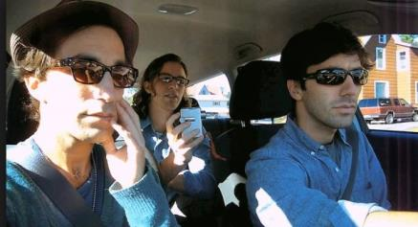
Performative
A performative documentary is when the film maker takes part in the film. Examples include Supersize Me and Catfish.
Subjective
Personal
Film-maker visible to audience
Film documents an event
Audience defines meaning
See unique perspectives

Slide 16
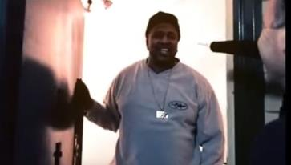
Realism
Documentaries aren’t completely real
Having the camera and crew there can affect events.
Shots are framed
Edited to appeal to target audience
Film Makers use certain techniques to create realism
Use natural light and hand held cameras (amateur effects)
Follow the action
Place audience in action
Use synchronous sounds
Film makers presence

Slide 17
Dramatisation
Documentaries have been called ‘a dramatisation of reality’
Documentaries can make real life seem more dramatic by how they are put together.
Dramatisation engages the audience
Documentaries can also uses actors to re-enact a situation that happened.
Dramatisation shows bias as the scenes can make reality more dramatic to entertain the audience or to make a point.

Slide 18
Narrativisation
Narrativisation is how a documentary is put together to make a story.
Based on actual events and information
The film maker takes the audience on a journey
Shots are sequenced in a particular way so a story can unfold.

Slide 19
References
https://issuesinfactualproduction.wordpress.com/2013/05/29/codes-and-conventions-of-factual-programming/
https://prezi.com/rl5wq2zvdupa/codes-and-conventions-of-factual-programming/
https://rumercooper.wordpress.com/boa-college/factual-programming-content-pg/codes-and-conventions-of-factual-prog/
http://productiontechniques12.blogspot.co.uk/2012/11/codes-conventions-of-documentary.html
http://www.slideshare.net/mattwako/factual-programming-10324123?related=1
http://www.slideshare.net/954869/codes-conventions-10458033
http://www.slideshare.net/Dan1401/6-types-of-documentary?next_slideshow=1
http://www.slideshare.net/cheffernan/reflexive-documentaries
https://en.wikipedia.org/wiki/Documentary_mode
http://productiontechniques12.blogspot.co.uk/2012/11/codes-conventions-of-documentary.html
http://www.slideshare.net/klmasters/what-is-documentary-realist-conventions
http://www.webofstories.com/play/billy.williams/15;jsessionid=E7080010DC0C267F52F9E0D4F9E23032
https://books.google.co.uk/books?id=HzcPuN6XCQIC&pg=PA146&lpg=PA146&dq=narrativization+in+documentary&source=bl&ots=wKGQNJTHba&sig=JyxuCz4ko_zIg-zfx4ju8TC7oyQ&hl=en&sa=X&ved=0CFgQ6AEwCWoVChMIkp2YmJm4yAIVyzcUCh1sPQEI#v=onepage&q=narrativization%20in%20documentary&f=false

