Slide 1
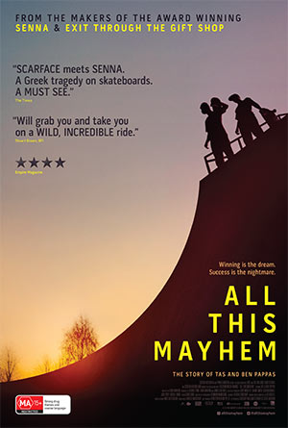
All this mayhem
By Michael Gomersall

Slide 2
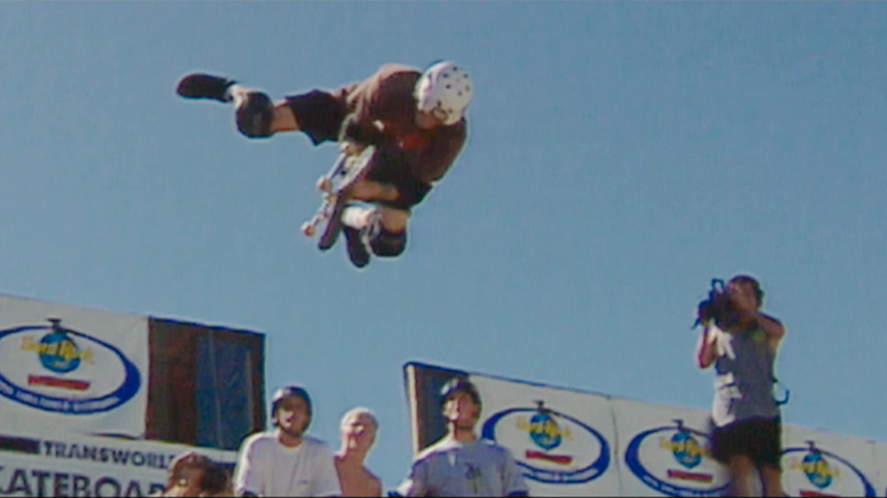
About the Movie
All this mayhem is about 2 brothers from australia in the 80’s, who ranked number 1 and 2 skateboarders in the world.
It is about their story, of them starting skating, of them as kids doing all sorts of stuff like stealing cars, and it continues on to the future when they are older and start taking heavy drugs etc.
This story has a lot of home footage from the 80’s, and has a documentary format, with the people who lived it back in the 80’s talking about their stories.

Slide 3
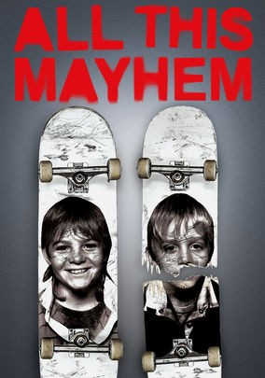
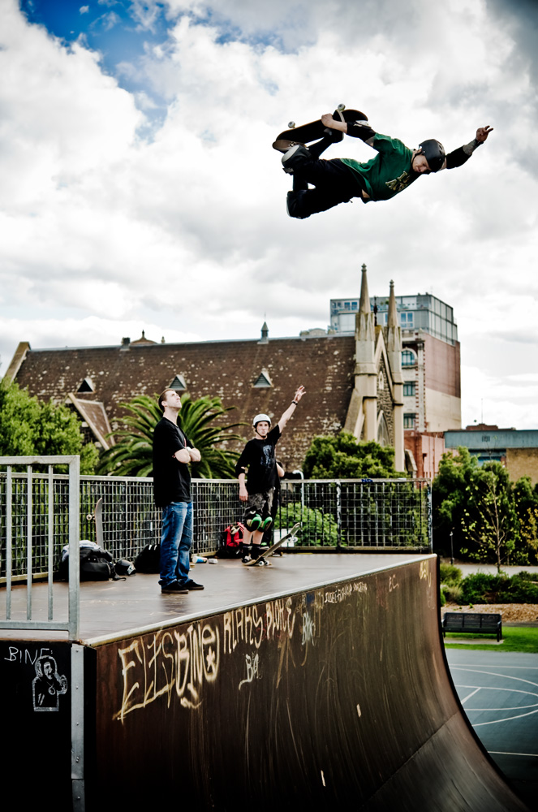
Target Audience
There are a few people who would be interested in this movie/documentary.
Skateboarders
People who lived through the 80’s
Teenagers/Youth
There are a lot of people who would be interested in this movie, as I have shown a lot of my friends who arent interested in skating and they loved it.

Slide 4
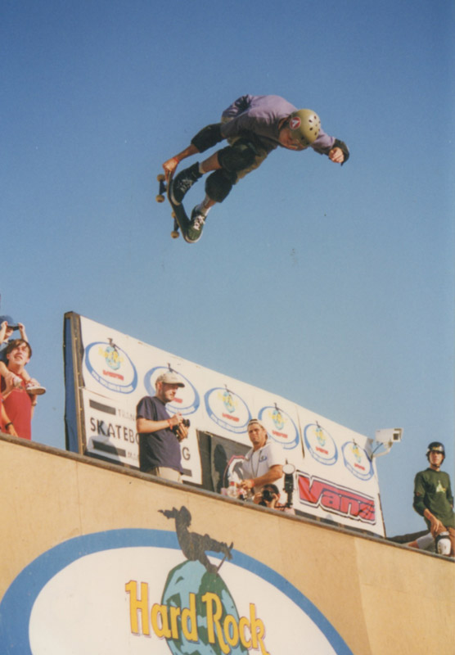
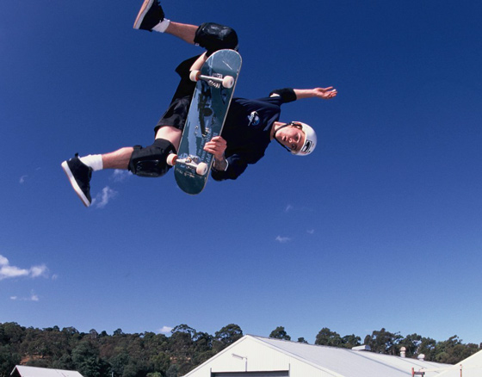
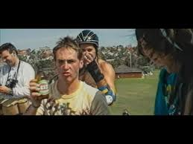
Images to Appeal
There is a lot of images of the brothers doing
skateboard tricks, and if you watch the documentary
there is a lot of footage of the things the
brothers got up to then they were younger
(Stealing cars, jumping off trains into
rivers, taking lots of drugs, and plenty of
other mad things).
If you watch the trailer https://www.youtube.com/watch?v=8wDiszmA2o8
you will see all the mad things
they do, and all the drugs they
take, which will make people
want to watch it as it is cool to
see that people lived like that.

Slide 5
Words and Font to Appeal
All this mayhem use more images to appeal to the audience rather than words.
There is nothing to read while you watch this movie, it is all visual.
Even on IMdB there is no review written, only a fan made one.
Most vice documentaries are like this.
The only words in the documentaries would be the leaderboards when they are all competing, and this is just normal writing on the screen.

Slide 6
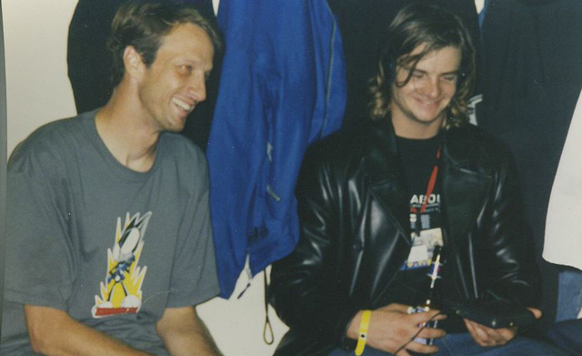
Colours to Appeal
The colours have a very 80’s/90’s effect.
There is a lot of home footage from the 80’s and 90’s,and that’s the way cameras were back then.
I think that this is a cool effect, and think its cool seeing all the styles people wore, and seeing people wearing the brands that I wear.

Slide 7
Audio to Appeal
There is a lot of music from the 80’s and 90’s in this movie, probably stuff that they would have listened to back then, and this targets people who lived through it all and would be watching it.
It also gives us a feel of the type of vibes there was, and the type of people they were.

Slide 8
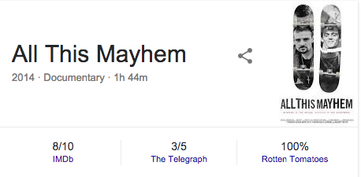
How can the producer find out what people think?
There are a lot of websites that review movies, for example IMDb and rotten tomatoes.
These websites let people from the public review movies, and say what they think about the movie.
This documentary has very good rating on websitets like IMDb and rotten tomatoes.

