Slide 1
Class task
Michael Gomersall
Connor MCcallion

Slide 2
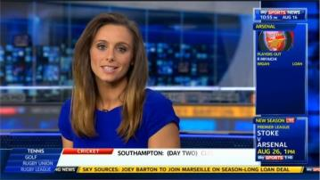
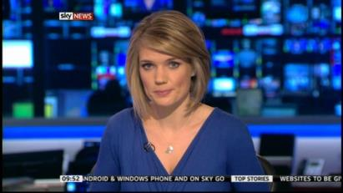
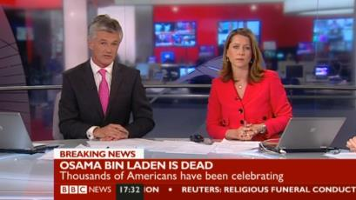
Studio News Readers
News presenters are important because they present the show. They have to get everyone’s attention and try and make the audience interested in the news topic.
They also have to write the script (most
Of the time) and make it interesting and
They have to make it not bias and have to
Have it factual.

Slide 3
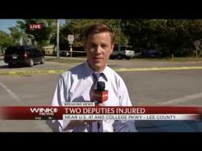
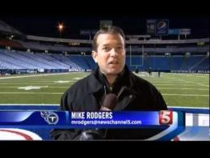
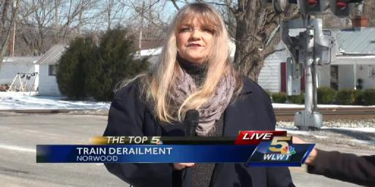
Field Reporters
Field Reporters are good because they go out and get primary research about the topic that they are talking about.
They go out and talk to people who witnessed the topic or who are affected by it and see what they think about it

Slide 4
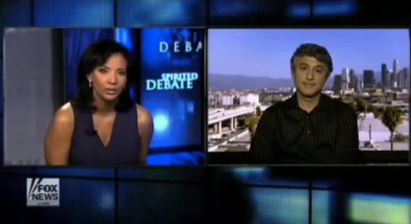
Links to Studio
Links to studio are good because they can show two different people in two different locations and have them talk about a certain topic.
It could have two news presenters in 2 different studios, or a news reader and a field reporter talking about something.

Slide 5
Mode of Address to Viewer
Mode of address is making the show appeal to the target audience for example the 60 second news is targeted towards younger people with a low attention span, it also has music and topics like celebrities. It is edited with a fast pace and this also makes it more interesting.

Slide 6
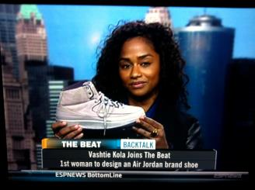
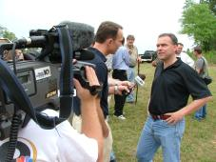
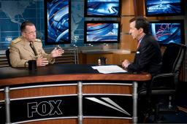
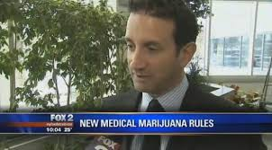
Interviewing
Interviews are important as they get first hand information about the topic, off someone who knows their stuff.
Interviews are could also be talking to someone who broke a record, or did something newsworthy and they could be talking about it.

Slide 7
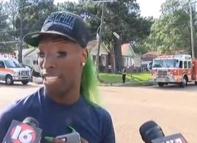
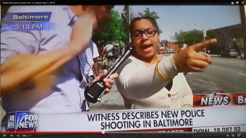
Experts and witnesses
It is always good to listen to what a expert has to say, as they know a lot about the topic.
It is also important that we hear from a witness as well, as they saw what happened and have first hand experience and they are a primary source.

Slide 8
Report Structure
This is basically what order they put the stories on the news are, and how they are structured.
This is what order the news stories are in, and not only the start, middle and end of the news show, but also the start middle and end of each piece of news.
It is basically just the structure of the show.

Slide 9
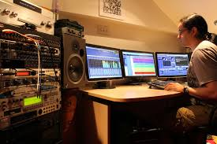
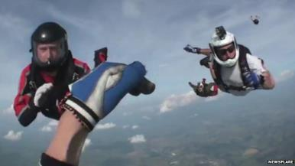
Actuality Footage
Actuality footage is import as people are more likely to believe and understand a story if they actually see it.
Actuality footage also makes the show far more interesting and keeps the audience wanting to watch it.

