Slide 1
Pitch for Fixers
Michael Gomersall

Slide 2
Fixers supports young people to make films about issues that affect them
Notes:
A brief ma. It might include background information such as a summary of the project and its target audience. It may provide guidelines, aims and objectives, budgets and deadlines

Slide 3
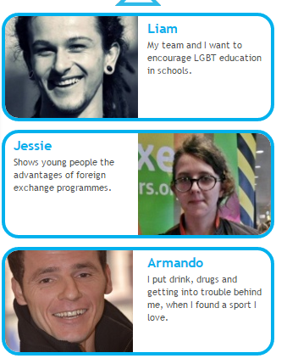
The Proposal
Our idea was to follow around some young people who were working on a Fixers project to show the work involved, the challenges and the fun of developing the media product

Slide 4
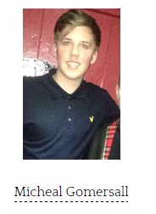
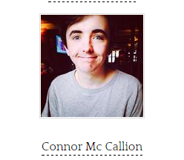
Crew
Director, Editor, Organiser, Assistant Director, Camera man, Camera man, pre-production Runner, pre-production
Sound

Slide 5
Treatment
Fly on the wall documentary style following the process that a fixers young person would go through.
Showing highs and lows from ideas generation, pre-production, production and post production and showing them showcasing their event.
We thought that some-one else in our course was going to do a fixers project and that it would be therefore very accessible to make

Slide 6
Equipment
A camera
A boom
A tripod
A computer with editing software

Slide 7
Budget
This budget is based on 8 hours filming
The ideas generation, pre-production and production could all be filmed together as we can do set ups for the first 2 and film the production as it is happening. (4hours)
We can do some filming of the post production editing etc (2 hours for this)
And also another time for the launch (2 hours)

Slide 8
Budget Breakdown
Crew wages £320 (8hours x2 crew)
Equipment hire
Camera £150
Tripod hire £ 40
Boom hire £ 35
Collar mic hire £15
Editing suite hire £ 60
Travel to launch £ 20
Total Budget £640

Slide 9
Locations
In and around the NWRC
Classrooms
Student support services

Slide 10
Risk Assessment
When we are filming do a quick visual risk assessment to
Check and make sure the floor isn’t wet,
There are no wires or other hazards to trip up on
The NWRC is very safety conscious so there should be no external health and safety issues
Ensure camera and other equipment is secure
Make sure no-one is messing about

