Slide 1
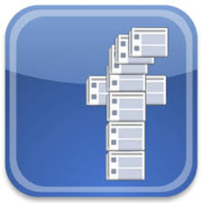
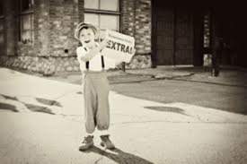
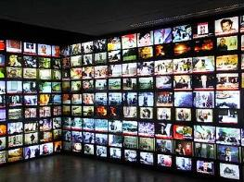
My Media Stories
by
Michael Gomersall

Slide 2
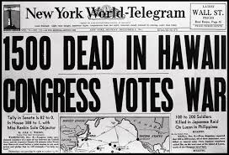
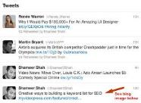
News Events
Death
Disaster
Terrorism
War
Politics
Crime
Public Interest
Notes:
People can get news from all sorts of different media. Whenever people think about news events, they often think of something bad that has happened, like the death of a celebrity, a natural disaster or a attack. The majority of news channels focus on the negative stories, rather than the positive(although you often get the odd story, like a child being saved from a well etc).
But what can the news do, because it has to inform us on things that are happening, and it can’t include every little event can it?
Whenever I think of a news event, only bad stories, like murders or natural disasters come to my mind.

Slide 3
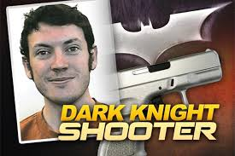
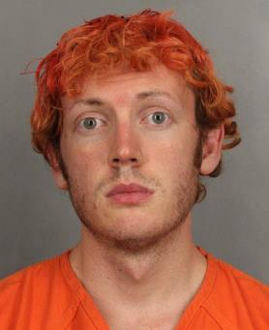
My News Event
Batman screening massacre
Notes:
The first news story that came to my head was the Batman Screening Massacre, where a man thought he was the joker and ran into a screening of batman and started shooting. He shot 12 people dead. Whenever the police went into his apartment his apartment was rigged with booby traps. The reason I Remember this event is because it was so big in the media, it was all over the news, the news papers, social media, and everyone was talking about it. It happened in 2012, and I still remember all the commotion it caused

Slide 4
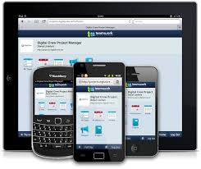
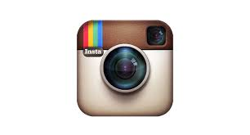
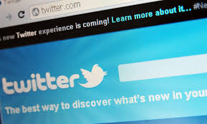
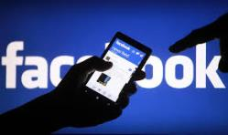
Technology
Technology is everywhere.
Growth of social media
Get news: unedited, as it is happens
Newsfeed websites e.g. BBC, Sky,
Notes:
There are new technology's, online business’s and more being invented everyday. I can remember most of technology's big events, like all the social medias like Bebo, Facebook, Tumblr, snapchat and instagram coming in. These let us know stories that are of interest to us.

Slide 5
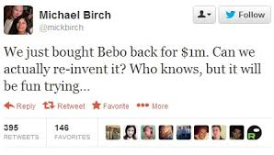
My Technology Event
Bebo – social networking site popular in Ireland & the UK
Owner Michael Birch sold the site to AOL for $850 million
Bebo lost popularity to Facebook
Bought the site back for $1million
To be re-launched this year as a messaging service

Slide 6
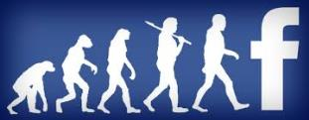
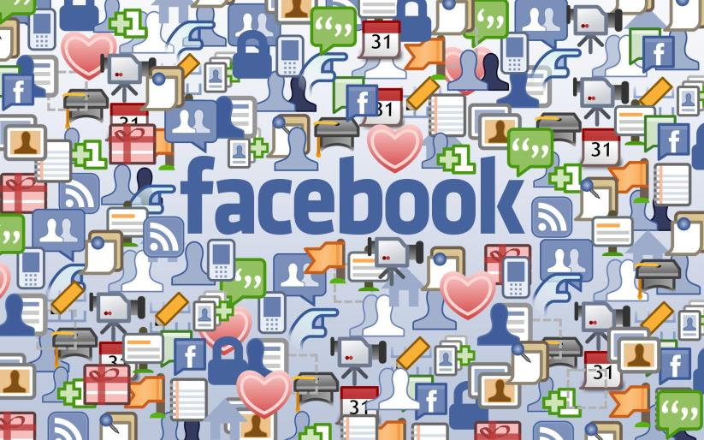
My Personal Event
,
Notes:
I spend hours a day on Facebook, talking to people and scrolling down my newsfeed. I remember the transfer from Bebo to Facebook, and remember being the first of my friends to go to Facebook, in 2008 I think it was. It has really changed my life, and got me connected with far more people and closer to people, and I couldn’t imagine my life without it now.

