Slide 1
Class task 8th of February
Jamie Keys
&
Michael Gomersall

Slide 2
Researching Organizations
There is various types of researching organizations out there that analyze things such as audience profiling etc. There are various organizations such as BARB, RAJAR and ABC. In this power point I am going to talk about them, and explain what they do.

Slide 3
BARB Broadcasters Audience Research Board
BARB is an agency that researches audience figures and various other statistics.
It features a TV player report which reports on TV.
It was set up in 1981 to provide the industry standard television audience measurement service for broadcasters and the advertising industry.
Barb gets different social class categories, and get them to review different TV shows, to see what classes are into what TV shows

Slide 4
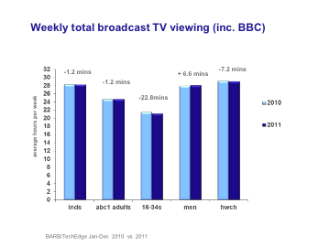
Example of Barb Research

Slide 5
RAJAR Radio Joint Audience Research
RAJAR Ltd (Radio Joint Audience Research) was set up in 1992 to align, design and operate a single audience measurement system for the UK radio industry serving both the BBC and licensed commercial stations.
RAJAR is responsible for setting the research specification, the awarding of the research contracts to third party suppliers and the overall quality control , management and delivery of the service.

Slide 6
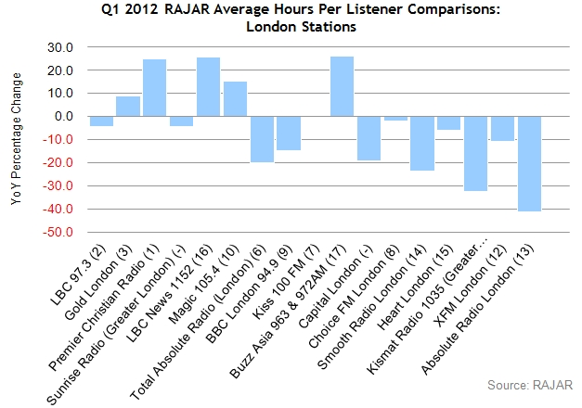
RAJAR Research Example

Slide 7
ABC Audit Bureau of Circulation
ABC publish reports throughout the year in various sectors, these reports are available to ABC members to view once they have played for access to them. ABC was Founded in 1931, and they wanted to analyse various sectors within the media industry.

Slide 8
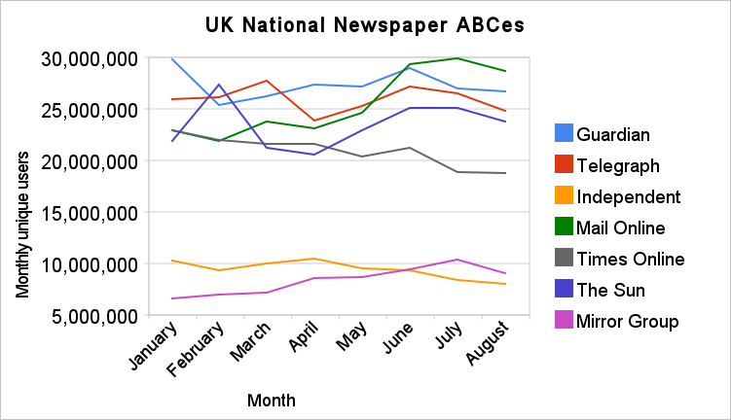
ABC Research Examples

