Slide 1
Types of Brief
Michael Gomersall

Slide 2
What is a Brief?
A brief lays out details of what is required from a media provider for a particular project including:
Name of project
Contacts
Background
Aims
Objectives
Guidelines
Audience
Timings
Budgets
Notes:
A brief ma. It might include background information such as a summary of the project and its target audience. It may provide guidelines, aims and objectives, budgets and deadlines

Slide 3
4 Types of Brief
Tender
Commission
Competition
Contract

Slide 4
Tender
In a tender the client advertises their brief and different production companies pitch for the contract with their ideas and their budget.
Advantages
The client gets choices. The production company gets experience.
Disadvantages
The production company may not get chosen but will have put a lot of resources into the pitch.

Slide 5
Examples of Tendering
Radio advertising campaign to promote young people into business 1
Marketing Programme for Keeping Scotland Beautiful 2
Tender for Gardeners Question Time on Radio 4 3
Tendering is often done by organisations with public money to be fair.
1 https://www.yortender.co.uk/procontract/attachment_19.nsf/dsp_frm_attachments/ATT-9SKE-CRFUOI/$FILE/Tender%20Brief%20for%20Radio%20Advert.docx
2 https://www.google.co.uk/url?sa=t&rct=j&q=&esrc=s&source=web&cd=11&cad=rja&uact=8&ved=0CB8QFjAAOApqFQoTCL-Zu_nhhcgCFcQ7FAodiAQDRg&url=http%3A%2F%2Fwww.keepscotlandbeautiful.org%2Fmedia%2F149343%2Fcommunications-itt-brief-7-oct-2013.pdf&usg=AFQjCNHjrXz1W8QW2t_d_vZEi7FktvACxw&sig2=FLySu9i2aYGaNE0-0yT1zw
3 https://www.google.co.uk/url?sa=t&rct=j&q=&esrc=s&source=web&cd=27&cad=rja&uact=8&ved=0CEIQFjAGOBRqFQoTCNa3847lhcgCFUfWFAod-UIKRQ&url=http%3A%2F%2Fdownloads.bbc.co.uk%2Fcommissioning%2Fsite%2Fgardeners-question-time-tender-2015.pdf&usg=AFQjCNGxK581djQ0-sceZMhPH8458VXH8g&sig2=b263-9feyFf_5pUnfnH__A

Slide 6
Commission
A commission brief is when a large media organisation (e.g. BBC, ITV) hires an independent media company to make a programme or a series for them.
Advantages
The client can buy the programming it needs without having to do all the admin on lots of different projects. The independent company can get its programmes seen and can earn money every time it is used or if it is sold on.
Disadvantages
The commission brief would need to be clearly negotiated so both sides know their rights and their roles. There could be conflict over creative or other differences.

Slide 7
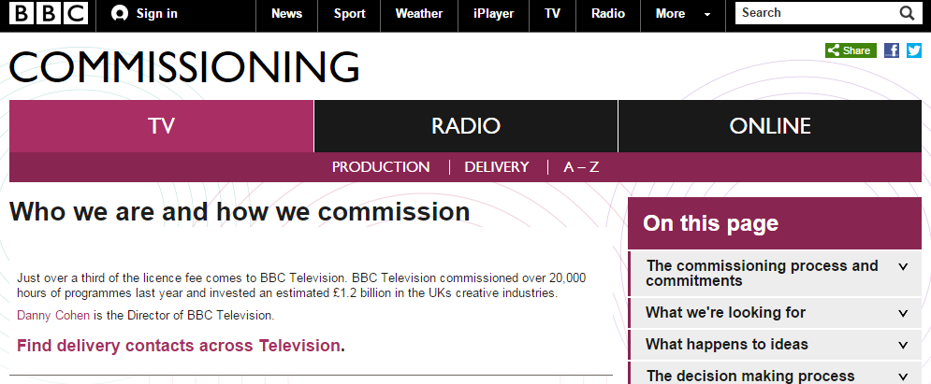
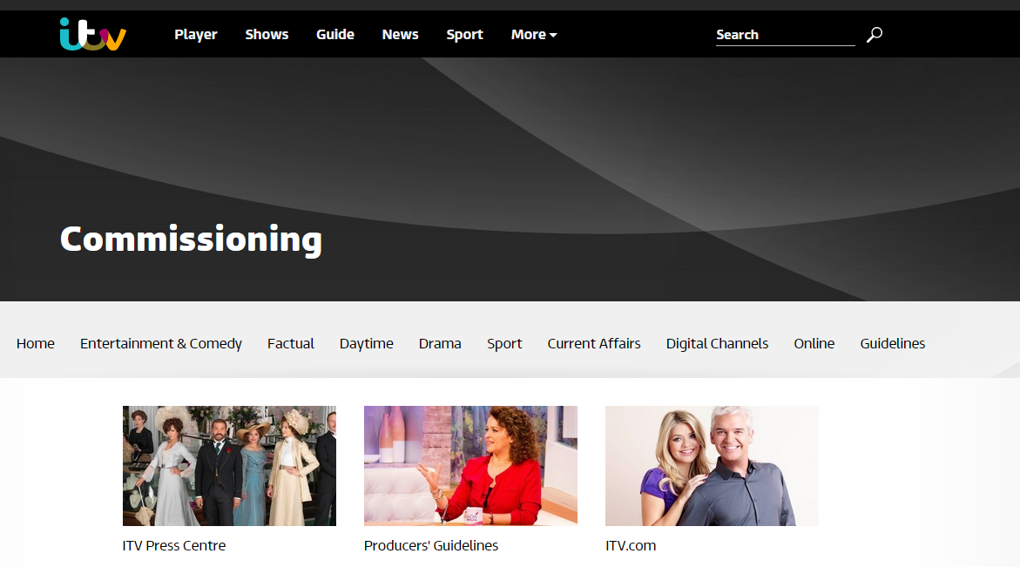
Examples of Commissioning
http://www.bbc.co.uk/commissioning/tv/articles/who-we-are-how-we-commission
http://www.itv.com/commissioning

Slide 8
Competition
A client can put out a brief as a competition where there is a reward of cash or of an opportunity. There will probably be lots more entries than their would be for a tendering brief which would take a lot of time to go through.
Advantages
A competition is a good way to break into the industry or to showcase talent. There is often a prize of money or of getting some publicity. It can help an individual or young company build up skills
Disadvantages
A lot of hard work, time and money can be used in entering a competition

Slide 9
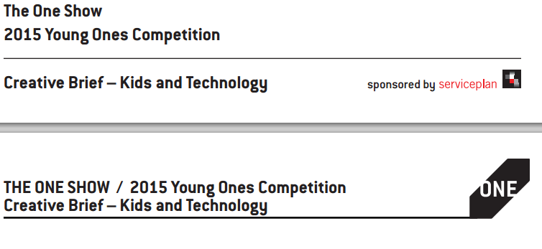
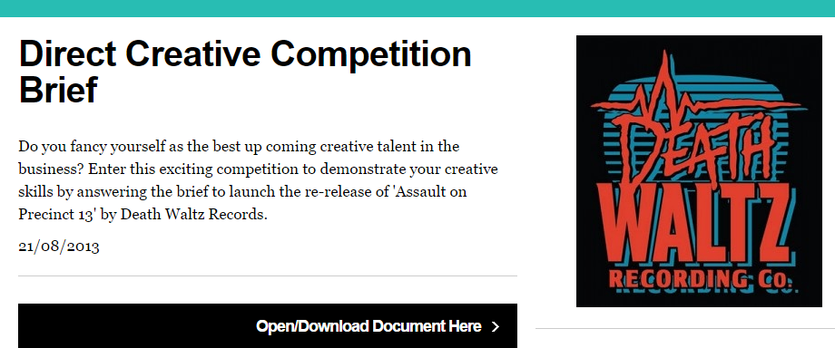
Examples of Competition
http://www.indiewire.com/article/sundance-institute-announces-short-film-challenge-regarding-extreme-poverty
http://www.oneshow.org/images/youngones/2015_YOS_KidsTech.pdf
http://www.ipa.co.uk/document/direct-creative-competition-brief

Slide 10
Contract
A contractual brief is when a client employs a media provider to complete a project for a specific job. The contract will include all the guidelines and is a legal document signed by both parties.
Advantages
Both parties know exactly what is expected of them.
Disadvantages
If the contract is breached there may be legal action which could be financially damaging as well as damaging reputation.

